Slide 1
Docker and Azure Container Service
[ Instructor Name ]
[ Instructor E-mail ]

Slide 2
Containers
Lightweight alternative to virtual machines
Smaller, less expensive, faster to start up, and self-contained
Virtual Machines
App
App
App
Libraries
Libraries
Libraries
Containers
Guest OS
Guest OS
Guest OS
App
App
App
Libraries
Libraries
Libraries
Hypervisor
Container Engine
Host Operating System
Operating System
Notes:
A virtual machine is -- well -- a virtualized machine created and managed by a hypervisor such as VirtualBox or Hyper-V. Even though a VM runs on a machine that has an operating system, each VM requires its own complete operating system, even if it's the same operating system as the host OS. VMs offer a very high degree of isolation, but at a cost: longer startup times, lower portability (ever tried to move a 127 GB virtual hard disk, or VHD, from one PC to another?), and higher memory requirements. Containers, by contrast, leverage the operating system that is already in place but offer nearly as much separation. RAM requirements are lower since the OS isn't being duplicated in each container, and cost is lower, too, because while cloud platforms typically charge for each VM, a single VM can host multiple container instances.

Slide 3
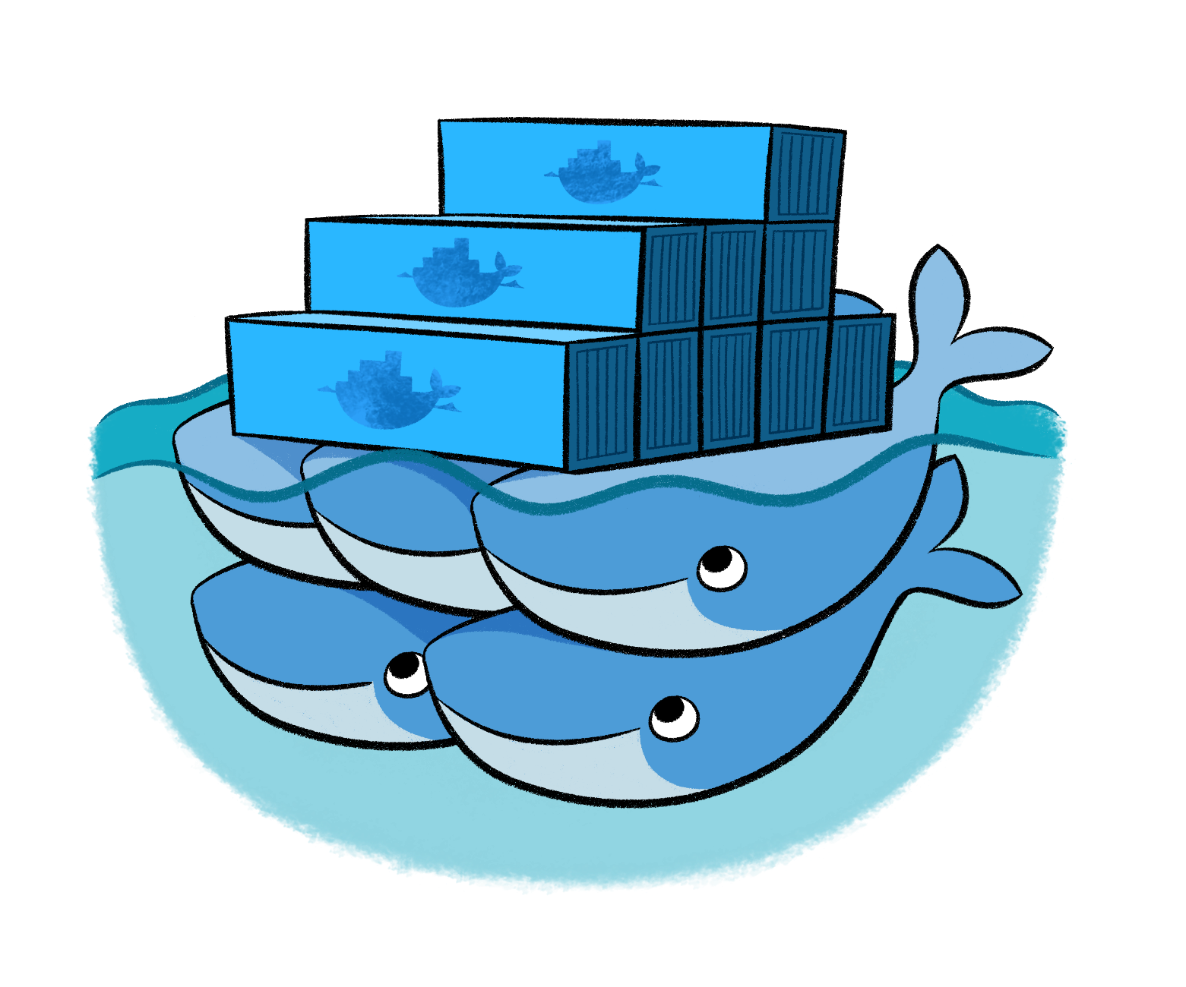
Docker
Leading open-source containerization platform
Supported natively in Azure
Docker containers wrap up a piece of software in a complete filesystem that contains everything it needs to run: code, runtime, system tools, system libraries – anything you can install on a server. This guarantees that it will always run the same, regardless of the environment it is running in
Notes:
Docker (www.docker.com) isn't the world's only containerization platform, but it is the most popular. It is free, open-source, and Linux-based, with Windows support (Windows Server 2016) in the works. It has earned massive mindshare in the developer community. And with Azure Container Service, you can deploy Docker containers to Azure with minimal effort. Moreover, Docker containers are easily moved between Azure and Amazon Web Services (AWS), affording developers portability between cloud platforms.

Slide 4
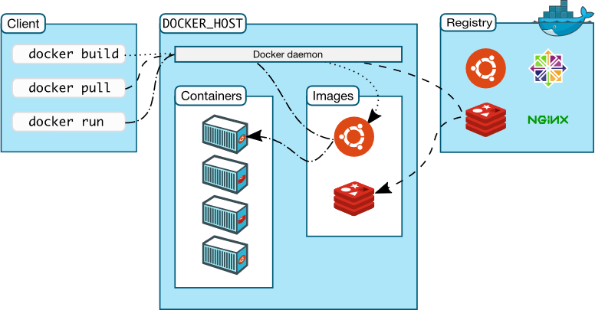
Docker Architecture
Notes:
Docker utilizes a client-server architecture. You execute Docker commands through a Docker client such as the Docker CLI or Kitematic. The client uses REST commands to communicate with the Docker daemon running on a Docker host such as the Azure Container services. These commands can be used to push, pull (docker pull), and create Docker images, to run them in containers, and to manage those containers. Images can be built with the docker build command, and they can be stand-alone, or they can "inherit" from other images. Images are stored in Docker registries, which can be public or private, local or remote. Docker Hub is a popular public registry that is managed by Docker; it contains a "huge collection" of images that anyone may use. The docker run command runs a container using an image as a template.

Slide 5
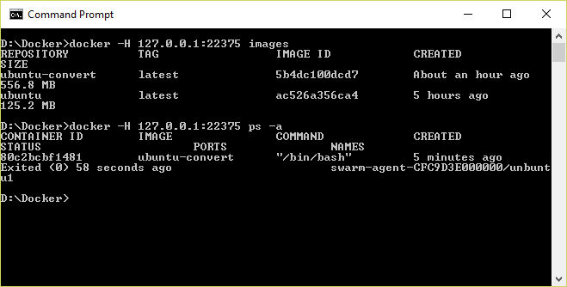
Docker CLI
Command-line interface for Docker, available for Linux, OS X, and Windows (available separately or as part of Docker Toolbox)
Notes:
The Docker Client, also known as the Docker CLI, is the primary tool you use to manage Docker containers. You can download container images from repositories such as Docker Hub, build container images, run container instances, list container images and instances, and much more. After connecting to Azure Container Service using SSH, you can use port forwarding to execute commands locally that act on an Azure Container Service running in the cloud. In this example, the -H switch used with the docker commands forwards commands sent to port 22375 on localhost to the Azure Container Services via SSH.

Slide 6
Running a Container
docker run -i -t ubuntu /bin/bash
Docker CLI command
Run container with interactive terminal
Pull "ubuntu" image from Docker Hub or local registry
Command to execute in the container
Notes:
This command pulls the image named "Ubuntu" from Docker Hub (or a local registry if the image is cached there) and runs it interactively in a container. "Interactively" means standard input, output, and error are connected locally so you can provide input to the container and see its output. Of course, you are not limited to the "Ubuntu" image. You can specify other images and even create images of your own with docker build. Where the container runs depends on the context. The container can run locally in a docker host (for example, a VM on Windows), or it can remotely if you connect to a remote Docker daemon (for example, one running in Azure) via SSH tunneling and use port forwarding to forward docker commands to the daemon.

Slide 7
Common Docker CLI Commands
docker run - Use an image to run a container
docker pull - Pull an image from a registry
docker build - Build a Docker image
docker images - List available Docker images
docker ps - List running Docker containers
docker exec - Execute a command in a container
docker stop - Stop a running container
Notes:
These are some of the most commonly used docker commands. You can also use docker push to push an image to a registry such as Docker Hub. Also, docker ps is often accompanied by a -a switch to list all containers, including those that are no longer running, while docker rm and docker rmi are used to delete (remove) containers and images, respectively. The docker build command uses a Dockerfile (a text file containing build commands) and a "context" -- for example, a specified directory in the file system -- to build Docker images.

Slide 8
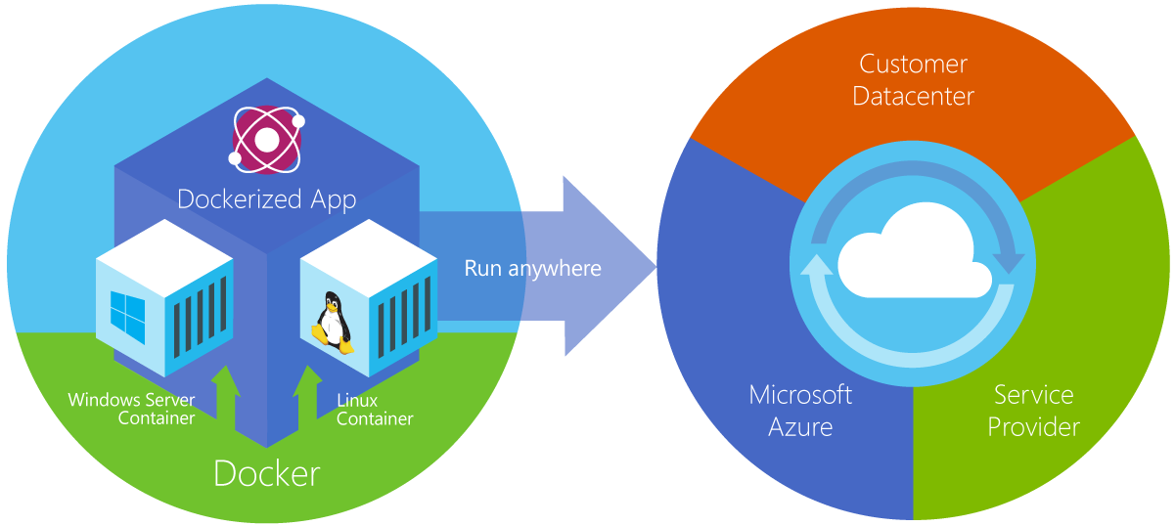
Azure Container Service
Provides robust, ready-to-use Docker hosting environment
Uses open-source orchestration tools (DC/OS and Swarm)
Notes:
From the documentation: "Azure Container Service makes it simpler for you to create, configure, and manage a cluster of virtual machines that are preconfigured to run containerized applications. It uses an optimized configuration of popular open-source scheduling and orchestration tools. This enables you to use your existing skills, or draw upon a large and growing body of community expertise, to deploy and manage container-based applications on Microsoft Azure." ACS supports Linux containers and Windows containers. The latter rely on Windows Server 2016.

Slide 9
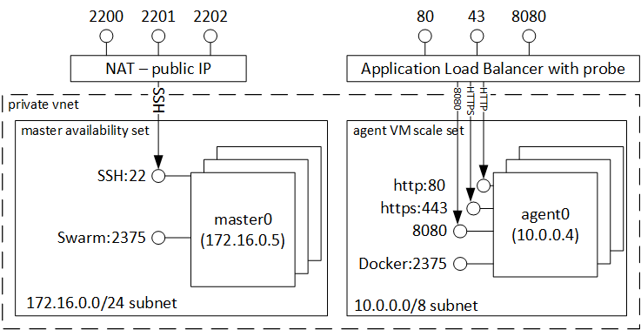
Clustering with Docker Swarm
Notes:
Here's what happens in Azure when you create an Azure Container Service with Docker Swarm as the orchestrator. Azure creates one or more master VMs to control the "swarm" of containers, as well as a Virtual Machine Scale Set, which provides the "agent" VMs in which containers run. All these VMs communicate over a private virtual network. To communicate with Docker Swarm in a master VM from a Docker client running on a local machine, you establish an SSH tunnel that forwards the local port 22375 to port 2375 in the VM (via SSH port 2200). This allows you to execute local commands that load container images and run containers in the cloud. Docker Swarm manages the container instances in the agent VMs as well as the agent VMs themselves. You don't have to know this to use Azure Container Service, but it does help explain various port forwarding commands that you employ when running the Docker client on a local machine connected to Azure.

Slide 10
Connecting to Docker Swarm in ACS
Establish SSH tunnel to master load balancer
Use port forwarding to forward local Docker commands to Docker daemon on master LB
ssh username@dnsname -p 2200 -L 22375:127.0.0.1:2375
Establish SSH connection via port 2200 (default is 22)
Forward commands transmitted through port 22375 by the Docker CLI to port 2375 on the other end
Notes:
This command works in a terminal window on OS X or Linux. (Windows users need to use a third-party SSH tool such as PuTTY.) The purpose of the -L switch is to forward traffic transmitted through port 22375 on the local machine (that's the port used by the Docker CLI) to port 2375 at the other end. Docker Swarm listens on port 2375. The -p switch instructs SSH to use port 2200 rather than the default 22. The load balancer you're connecting to listens on port 2200 and forwards the SSH messages it receives to port 22 on the master VM.

Slide 11
Hands-On Lab
Docker and Azure Container Service HOL.html

